Slide 1
SQL BOOK STORE ANALYSIS
SQL Beginner Level Project
Prepared By: Rahul Kumar
Diploma in Computer Science

Slide 2
PROJECT OVERVIEW
This project is based on a Book Store Management System.
SQL is used to manage Books, Customers, and Orders.
rk
Suitable for beginner level students.
Covers basic & advanced SQL queries.

Slide 3
DATABASE STRUCTURE
1.Books Table
Book ID (Primary Key), Title, Author,
Genre, Published Year, Price, Stock
2.Customers Table
customer ID(Primary Key), Name, Email,
Phone, City, Country
3.Orders Table
Order ID (Primary Key), Customer ID (Foreign Key), Book ID (Foreign Key), Order Date, Quantity,
Total Amount

Slide 4

Query 1: Retrieve all books in the Fiction genre
Comment:-- This query selects all columns from the Books table where genre is Fiction
Analysis:-
This query is used to filter books based on their genre. The WHERE clause ensures only Fiction books are displayed.

Slide 5

Query 2: Find books published after 1950
Comment:-- This query retrieves books published after the year 1950.
Analysis:-
It helps in finding relatively modern books by comparing the published year.

Slide 6

Query 3: List all customers from Canada
Comment:-- This query fetches customer records where the country is Canada.
Analysis:-
Useful for country-based customer analysis.

Slide 7
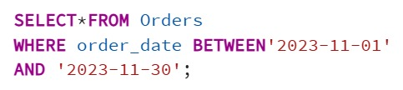
Query 4: Show orders placed in November 2023
Comment:-- This query filters orders placed within November 2023.
Analysis:-
The BETWEEN operator is used to select a range of dates.

Slide 8

Query 5: Retrieve total stock of books available
Comment:-- This query calculates the total stock of all books.
Analysis:-
SUM() aggregate function is used to get total available inventory.

Slide 9

Query 6: Find the most expensive book
Comment:-- This query sorts books by price in descending order and returns the top record.
Analysis:-
Useful to identify premium-priced books.

Slide 10

Query 7: Show orders where quantity is more than 1
Comment:-- This query retrieves orders with quantity greater than one.
Analysis:-
Helps to identify bulk purchases.

Slide 11

Query 8: Retrieve orders where total amount exceeds 20
Comment:-- This query filters orders with total amount greater than 20.
Analysis:-
Used for analyzing higher-value orders. Analysis:Used for analyzing higher-value orders.

Slide 12

Query 9: List all available genres
Comment:-- This query retrieves unique genres from the Books table.
Analysis:-
DISTINCT removes duplicate genre values.

Slide 13

Query 10: Find the book with the lowest stock
Comment:-- This query finds the book with minimum stock.
Analysis:-
Helps identify books that need restocking.

Slide 14
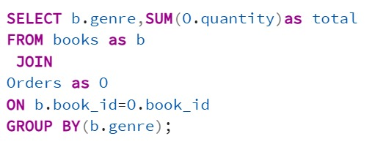
Query 11: Total number of books sold for each genre
Comment:-- This query calculates total books sold per genre using JOIN and GROUP BY.
Analysis:-
Combines Books and Orders tables to perform genre-wise sales analysis.

Slide 15

Query 12: Average price of Fantasy books
Comment:-- This query calculates average price of Fantasy genre books.
Analysis:-
AVG() helps in pricing analysis for a specific genre.

Slide 16
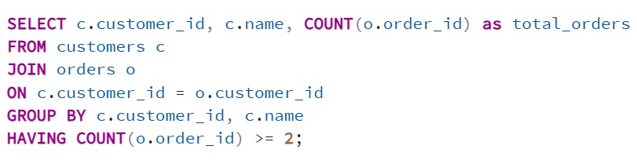
Query 13: Customers who placed at least 2 orders
Comment:-- This query finds customers who have placed two or more orders.
Analysis:-
HAVING is used with aggregate functions for filtering grouped data.

Slide 17
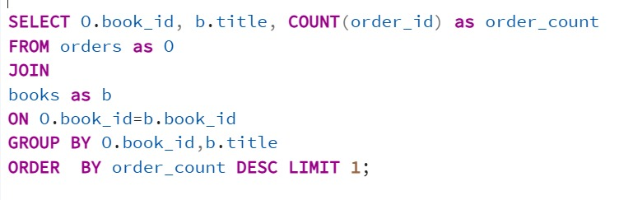
Query 14: Most frequently ordered book
Comment:-- This query identifies the most frequently ordered book.
Analysis:-
Useful to find best-selling books.

Slide 18
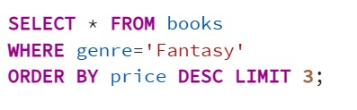
Query 15: Top 3 most expensive Fantasy books
Comment:-- This query retrieves top 3 expensive Fantasy books
Analysis:-
Used for premium book analysis.

Slide 19
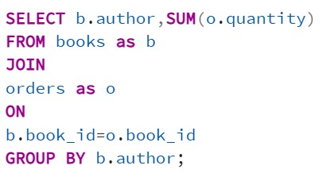
Query 16: Total quantity of books sold by each author
Comment:-- This query calculates total books sold by each author.
analysis:-
Helps evaluate author performance.

Slide 20
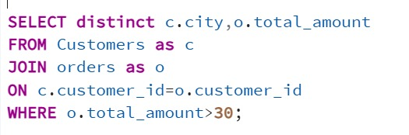
Query 17: Cities where customers spent over $30
Comment:-- This query finds cities of customers who spent more than $30.
Analysis:-
Useful for geographical sales analysis.

Slide 21
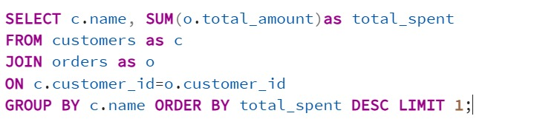
Query 18: Customer who spent the most
Comment:-- This query identifies the highest spending customer.
Analysis:
-Helps identify valuable customers.

Slide 22
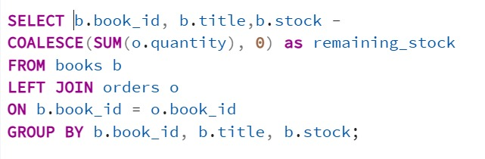
Query 19: Remaining stock after fulfilling all orders
Comment:-- This query calculates remaining stock after deducting ordered quantity.
Analysis:-
LEFT JOIN ensures books with no orders are also included. :-

Slide 23
CONCLUSION
Learned basic & advanced SQL queries
Used JOIN, GROUP BY, HAVING
Suitable for beginner level project
Strong foundation for database concepts

